Slide 1


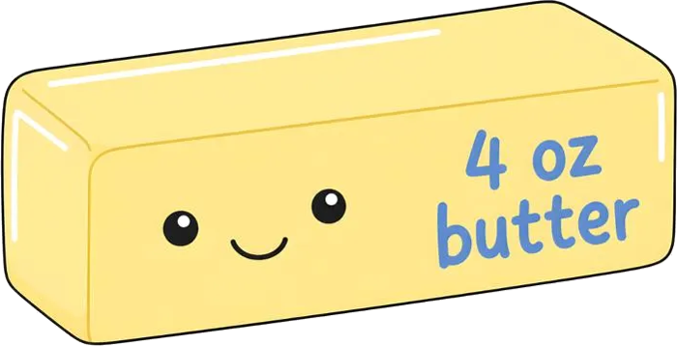
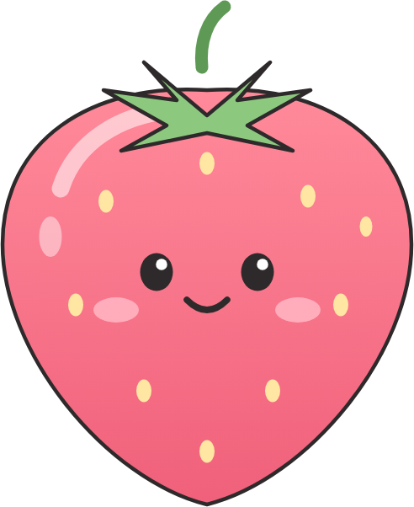
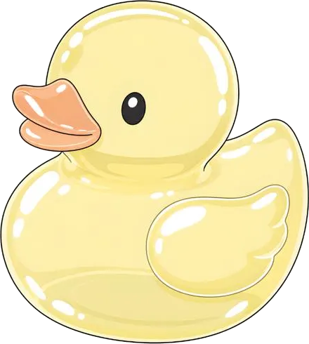

Does a fidget toy help or hurt learning?
AIPI 510 · MODULE PROJECT 2
An experiment on squishy toys and video recall
Sabrina Grewal & Haydn Stucker · Duke University · Nov 3, 2026
Notes:
Hi everyone. We’re Sabrina and Haydn. Our project asks a simple question: does fidgeting with a squishy toy while you watch something help you learn it, or does it get in the way? We ran a small experiment to find out.

Slide 2



Fidget toys are sold as focus tools, especially for ADHD
MOTIVATION
15.5M
U.S. adults (6.0%) had a current ADHD diagnosis in 2023
But prior research suggests fidgeting can hurt:
Graziano et al. (2020): spinners increased inattention in 60 children with ADHD
Soares & Storm (2020): students using spinners remembered less from a video lecture
Our gap: do quiet squishies get in the way too?
Source: Staley et al., CDC MMWR 73(40), 2024
Notes:
About 15.5 million U.S. adults, 6 percent, had a current ADHD diagnosis in 2023, and fidget toys like these squishies are widely marketed as focus tools, especially for ADHD. But the research gives reason to be skeptical: Graziano and colleagues found fidget spinners increased inattention in 60 children with ADHD, and Soares and Storm found college students using spinners remembered less from a video lecture. Spinners are noisy and visual, though. Squishies are quiet and you don’t have to look at them, so we asked whether they still get in the way of learning.

Slide 3
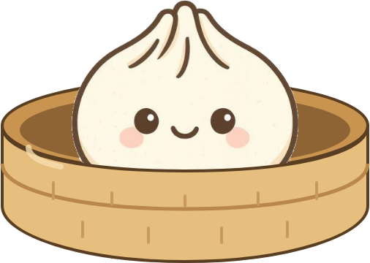
Does using a fidget toy while watching a short video change how much people remember?
RESEARCH QUESTION
Null hypothesis (H₀)
Alternative hypothesis (H₁)
μfidget − μno fidget = 0
μfidget − μno fidget ≠ 0
Mean quiz scores are the same with and without a fidget toy.
Mean scores differ. Two-sided, because a toy could help or hurt recall.
Notes:
Our research question: does using a fidget toy while watching a short video change how much people remember? Our null hypothesis is that mean quiz scores are the same in both conditions; our alternative is that they differ. We made the test two-sided on purpose: based on the ADHD marketing, a toy could help, and based on the earlier studies, it could hurt.

Slide 4
Two groups, one video, one quiz
THE EXPERIMENT
Element | What we did
Independent variable | Squishy toy in hand vs. no toy
Dependent variable | Quiz score, 0–10 correct
Control condition | Same video, quiz app and procedure, no toy
Assignment | In pairs, one to each group; split by us, not at random
Procedure | In person: watch a 4.5-min TED-Ed video on why animals play dead, then a 10-question quiz
Planned test | Two-sided Welch independent-samples t-test
The fidget toy:
a squishy
Notes:
We ran a between-subjects experiment. The independent variable was whether participants held a squishy like this one while watching; the dependent variable was their score on a 10-question quiz. Everyone watched the same 4.5-minute TED-Ed video about why animals play dead, a topic most people don’t already know, in our quiz app, then answered the questions one at a time with the video hidden. The control group had the identical setup without a toy, and we assigned people in pairs, one to each group, to keep the groups the same size. We chose which member of each pair went to each group, so the groups weren’t randomized; we come back to that in the limitations. We planned a two-sided Welch t-test to compare the groups.

Slide 5
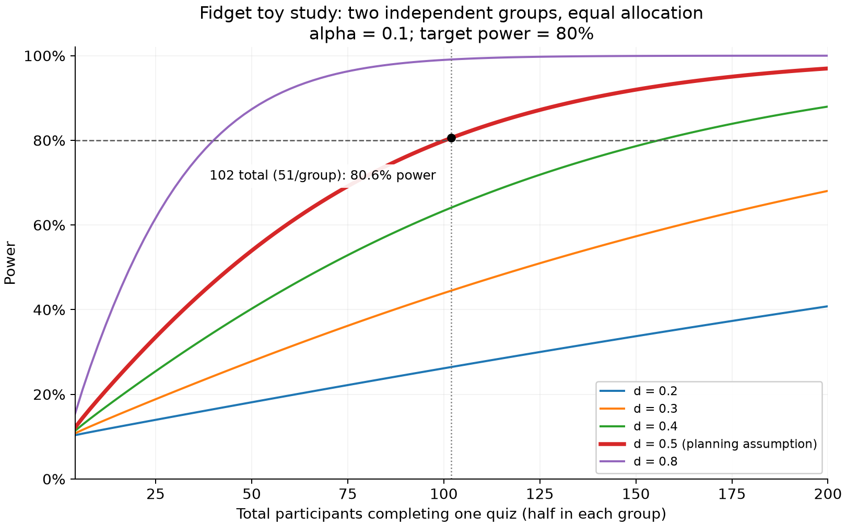
102 people needed for 80% power
POWER ANALYSIS
Smallest meaningful effect: 1 question; assumed SD 2 → d = 0.50
Two-sided, α = 0.10, power = 80% (statsmodels TTestIndPower)
51 per group, 102 total;
a large effect (d = 0.8) needs 42
Why α = 0.10, not the usual 0.05?
For a small exploratory study, we chose α = 0.10 and 90% CIs: more power, at a 10% false-positive risk. Pilot guidance supports looser thresholds (Lee et al., 2014).
Notes:
Before collecting data, we ran a power analysis with statsmodels. We set the smallest meaningful difference at one question out of ten and assumed a standard deviation of two questions, a medium effect of d = 0.5. Because this was a small exploratory study, we set alpha at 0.10 and report 90 percent intervals. That gives more power at the cost of a 10 percent false-positive risk, in line with guidance that pilot studies can use looser thresholds. At 80 percent power, that needs 51 people per group, 102 total, the number on this slide.

Slide 6
An in-person, controlled experiment
DATA COLLECTION & CLEANING
We ran sessions in person with a researcher present, using the same video and quiz app for everyone. That control took time: over about 10 days we reached 12 participants, far fewer than the 102 our power analysis said we needed.
6 vs 6
Oct 22–31
0
Fidget vs. no fidget, assigned in pairs; one no-show replaced
In-person sessions with a researcher present
Quizzes excluded: all passed completeness, group and duplicate checks
How the data flowed
Flyer
Streamlit app
GitHub
Python checks
Clean data
Recruits without
mentioning the toy
Video, then a
10-question quiz
Auto-saves each
quiz as a CSV
Validates and scores
every quiz
De-identified scores,
P01–P12
Notes:
We chose to run this as an in-person, controlled experiment. A researcher was present to hand out and collect the squishy, and everyone used the same video and the same quiz app. That control takes time, so over about ten days of sessions we reached 12 participants, well short of the 102 our power analysis said we needed. Six were in the fidget group and six in the control group, assigned in pairs; one no-show in the fidget group was replaced. The bottom row shows how the data flowed. Our flyer never mentioned the toy, so people didn’t know what we were testing. Each person watched the video and took the quiz in our Streamlit app, which saved every quiz to our GitHub repo as a CSV. Our cleaning script then checks every raw file: exactly one answer per question, the group matches the recorded condition, and nobody appears twice. All twelve passed, so nothing was excluded, and the script saves de-identified scores, P01 through P12.

Slide 7
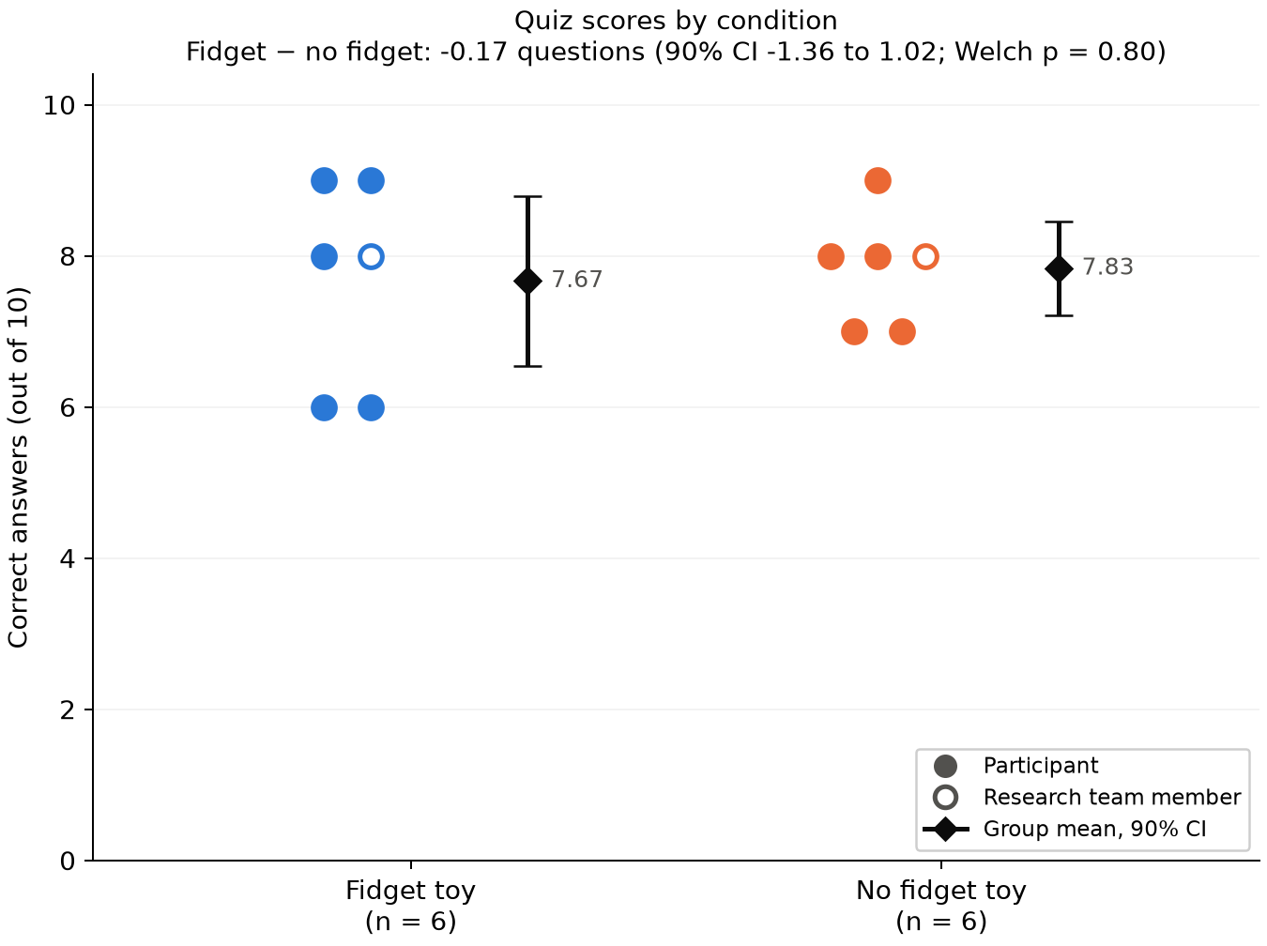
Both groups scored about the same
KEY RESULT
7.67
7.83
Fidget toy (n = 6)
No fidget toy (n = 6)
A difference of just 0.17 questions, not statistically significant (p = 0.80).
Notes:
Here are the results. Each dot is one person. The fidget group averaged 7.67 out of 10 and the no-fidget group 7.83, a difference of less than a fifth of a question. The confidence intervals overlap almost completely, and the difference was not statistically significant, with a p-value of 0.80. Interestingly, with our first nine participants the gap was a full question; three more people shrank it to almost nothing, which shows how unstable small samples are. The hollow dots are the two of us, which matters for the sensitivity check coming up.

Slide 8
Welch’s t-test: no significant difference
STATISTICAL ANALYSIS
Statistic | Value
Mean difference | −0.17 questions
90% confidence interval | −1.36 to 1.02
Welch t (df) | −0.26 (7.78)
p-value | 0.80
Hedges’ g | −0.14
Why Welch, and checks
Two independent groups, one score each
Doesn’t assume equal variances (SDs 1.37 vs. 0.75)
n = 6 per group: normality can’t be checked reliably
Sensitivity check
Without the 2 research-team members (5 vs. 5)
Difference −0.20, 90% CI −1.70 to 1.30, p = 0.80
Same conclusion as with all 12
Notes:
We compared the groups with Welch’s t-test. It fits two independent groups and doesn’t assume equal variances, which matters here because the spreads differed: 1.37 versus 0.75. The mean difference was negative 0.17 questions, t of negative 0.26, p = 0.80, and Hedges’ g of negative 0.14, a very small effect. With six people per group we can’t meaningfully check normality, so we read the result cautiously. Two participants were the two of us and knew the hypothesis, so as a sensitivity check we re-ran the test without our data: the difference was negative 0.20, p = 0.80, the same conclusion.

Slide 9

What the confidence interval tells us
INTERPRETING THE RESULT
90% CI: −1.36 to +1.02 · estimate −0.17
hurts
helps
−1 question
0 (no effect)
+1 question
It includes 0
It’s wide
Low power: ~21%
So we fail to reject H₀: no detectable difference.
The toy could hurt by ~1.4 questions or help by ~1: we can’t tell.
With 6 per group (vs. 51 needed),
“no effect” isn’t proven.
Notes:
Here’s how to read our result. The dark bar is the 90 percent confidence interval for the difference in quiz scores, fidget minus no fidget, from about negative 1.4 to positive 1.0 questions. The orange dot is our estimate, negative 0.17. First, the interval includes zero, so we fail to reject the null hypothesis. Second, it’s wide: it reaches past our one-question threshold in the “hurts” direction and right up to it in the “helps” direction. So our data are compatible with the toy hurting, helping or doing nothing. And with six people per group instead of the 51 we needed, we had only about a 21 percent chance of detecting a one-question effect. So absence of evidence is not evidence of absence: we can’t conclude that squishies have no effect, only that our study couldn’t detect one.

Slide 10
What limits our conclusions
LIMITATIONS
Tiny sample
Groups not randomized
12 completers vs. 102 needed; ~21% power
We split each pair ourselves, not at random, so groups could differ in more than the toy
Team members as participants
Convenience sample, no ADHD screening
2 of 12 knew the hypothesis; checked with a sensitivity analysis
Friends and classmates, not screened for ADHD; may not generalize, especially to people with ADHD
Protocol deviations
Quiz quality
One no-show replaced; 5 quizzes off-schedule, 2 taken at the same time
Q2, 9, 10 nearly everyone got right; on Q5, half chose “fight or flight”
Notes:
The biggest limitation is sample size: twelve people instead of 102, which is why power was so low. Second, the groups weren’t randomized: we chose ourselves which member of each pair joined which group, so the groups could differ in ways other than the toy. Two participants were us and knew the hypothesis, though the sensitivity analysis gave the same answer. Everyone was a friend or classmate, and even though ADHD motivated the study, we didn’t screen for it, so our results may not generalize, especially to people with ADHD. We also deviated from our plan: one no-show was replaced, and five quizzes were taken after the planned dates, two of them at the same time. Finally, the quiz itself: questions 2, 9 and 10 were answered correctly by all or all but one person, so they barely separate people, and on question 5 half the participants picked “fight or flight” instead of the correct “resting and digesting.”

Slide 11
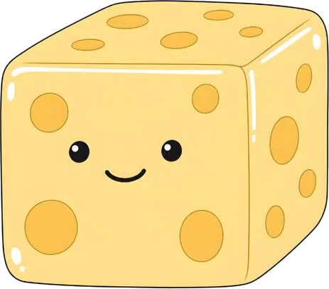
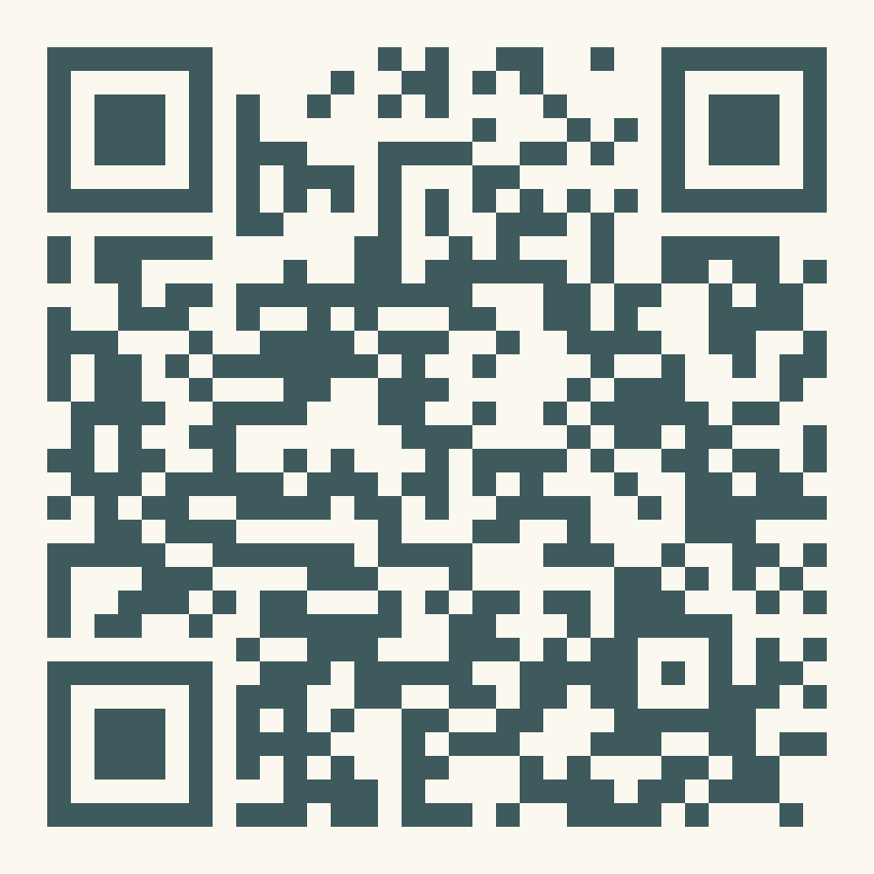
Inconclusive, but a useful pilot
TAKEAWAYS & RECOMMENDATIONS
What we found
In practice
Next time
Squishy users scored 0.17 questions lower (p = 0.80). With ~21% power, the study was too small to tell if squishies help or hurt.
Treat squishies as a comfort preference, not a learning tool. ADHD focus claims need testing with ADHD participants.
~16–39 per group at α = 0.10 (from our SD of 1.10 and its 90% CI), screen for ADHD, and fix the easy and tricky questions.
Everything is on GitHub
Quiz app, raw data, analysis scripts and reports: github.com/haydn-s/sourcing-data-project-2
References: Staley et al., CDC MMWR (2024) · Graziano et al. (2020) · Soares & Storm (2020) · Lee et al. (2014)
Notes:
To wrap up: people using a squishy scored just 0.17 questions lower, not statistically significant. With about 21 percent power, our study was too small to tell whether squishies help or hurt, so we treat it as a pilot. In practice, that means students and teachers should treat squishies as a comfort preference rather than a learning tool, and the ADHD focus claims need to be tested with people who have ADHD. For a follow-up at the same alpha of 0.10, the spread we observed, a standard deviation of about 1.1, means about 16 people per group would give 80 percent power, or about 39 per group if the true spread is at the top of its confidence interval. We’d also screen for ADHD and fix the quiz questions that were too easy or confusing. Our code, data and analysis are all in our GitHub repo; the QR code links to it. Thanks, we’re happy to take questions.

